Slide 1
Testing Framework Introduction
Javeria Kemall

Slide 2
What is Selenium?
Selenium refers to a suite of tools that are widely used in the testing community when it comes to cross-browser testing. Selenium cannot automate desktop applications; it can only be used in browsers. It is considered to be one of the most preferred tool suites for automation testing of web applications.
Compatible with multiple browsers and languages.

Slide 3
Selenium Components
The Selenium test suite comprises four main components:-
Selenium IDE
Selenium RC
Selenium Webdriver
Selenium Grid

Slide 4
Selenium Grid is a tool that is used for concurrent execution of test cases on different browsers, machines, and operating systems simultaneously. This tool makes Cross-browser compatibility testing very easy
Selenium WebDriver allows you to develop responsive design tests

Slide 5
Basic Steps in a Selenium WebDriver Script
Create
Create a WebDriver instance.
Navigate
Navigate to a webpage.
Locate
Locate a web element on the webpage via locators in selenium.
Perform
Perform one or more user actions on the element.
Preload
Preload the expected output/browser response to the action.
Run
Run test.
Record
Record results and compare results from them to the expected output.

Slide 6
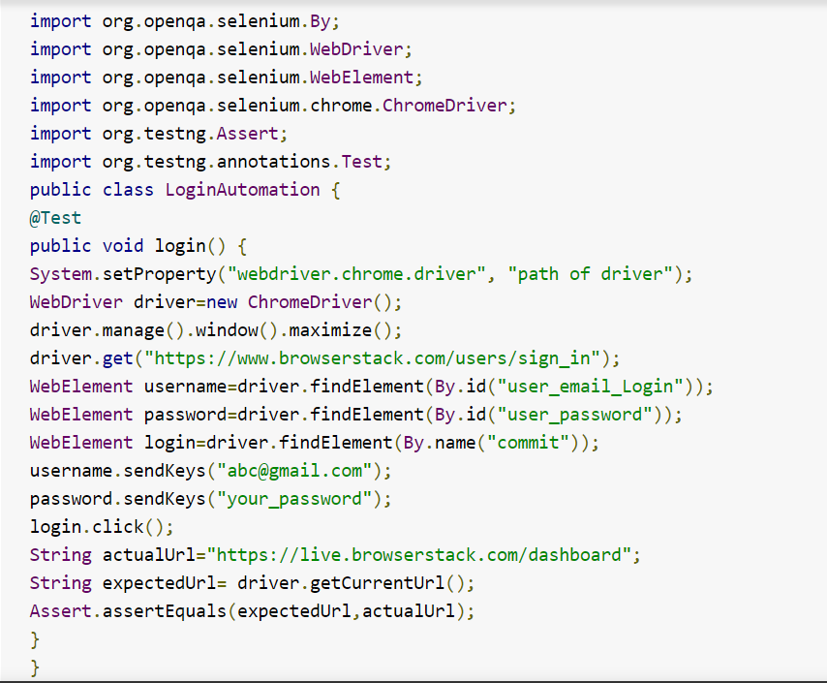

Slide 7
Maven
Installation
Maven is a Java tool, so you must have Java installed in order to proceed.
First, download Maven and follow the installation instructions. After that, type the following in a terminal or in a command prompt:
mvn --version

Slide 8
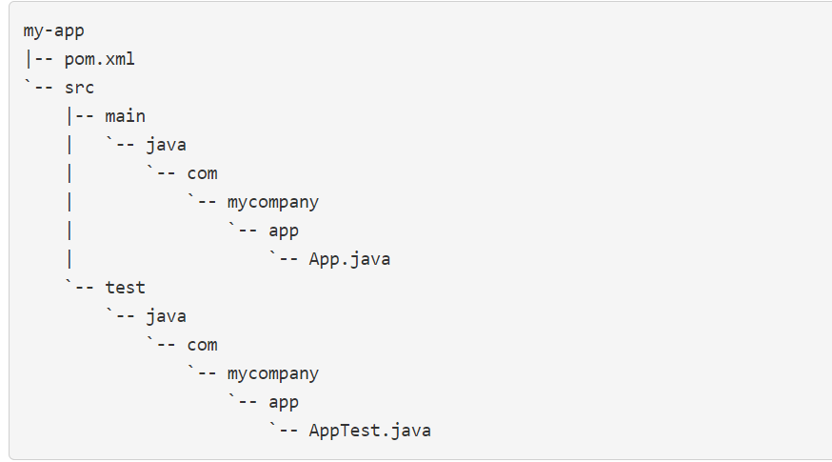
Structure

Slide 9
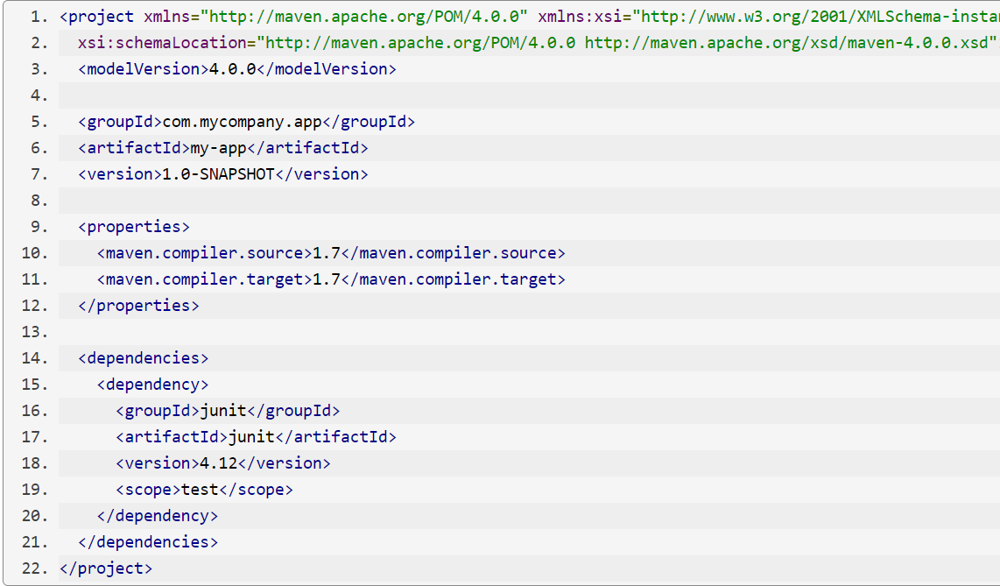
Pom.xml
The pom.xml file is the core of a project's configuration in Maven. It is a single configuration file that contains the majority of information required to build a project in just the way you want. The POM is huge and can be daunting in its complexity, but it is not necessary to understand all of the intricacies just yet to use it effectively. :

Slide 10
ATOM by Accenture
A series of loosely coupled java libraries with code collected from multiple test projects.
The aim is to allow new test projects to re-use these libraries and to focus primarily on developing the test cases and test code itself rather than the typical heavy upfront investment in framework creation.
The libraries include support for:
api testing
browser testing
mobile app testing
output reporting
database connectivity
ssh connectivity and running backend server commands (to be added)
test data factory(to be added)
interface mocking(to be added)
parallel test execution
jira integration

Slide 11
ATOM for Selenium
A sample project using various automation libraries for web and mobile test execution using TestNG.
library-common
library-selenium
Gradle
at Files · master · Javeria Kemall / Sample-dvwa-selenium · GitLab (aeo3.ca)

